Slide 1


Slide 2

The Event Handling Process
Event Classes
Semantic Event Handling in an Application

Slide 3

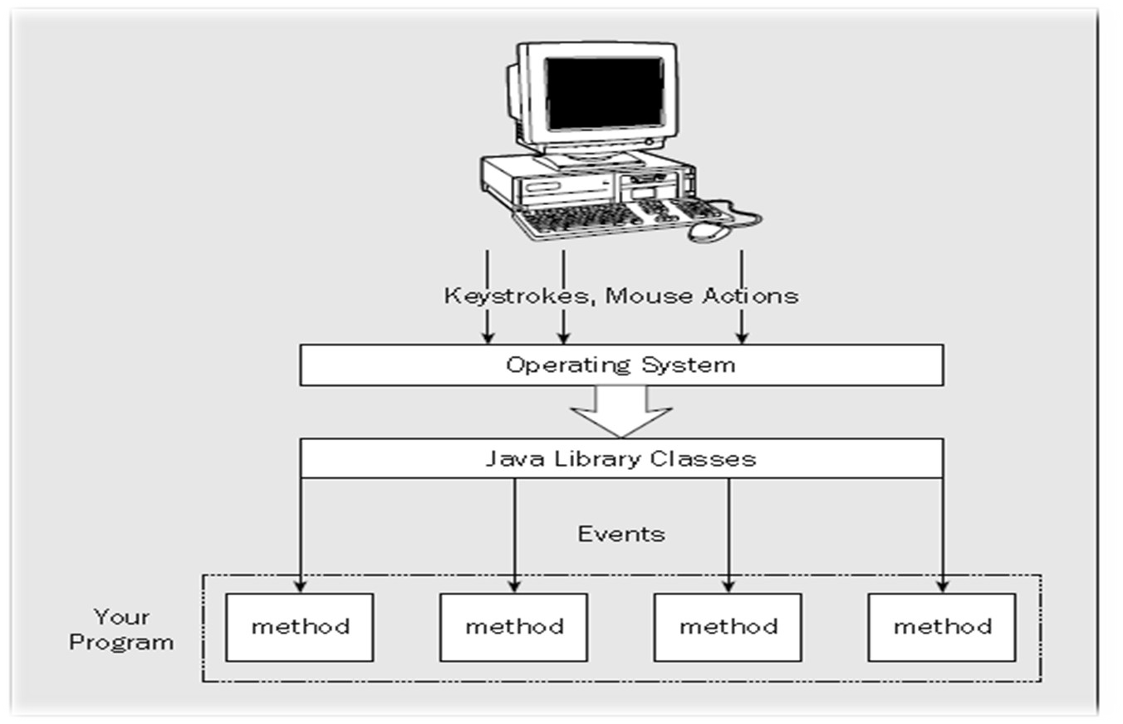

Slide 4
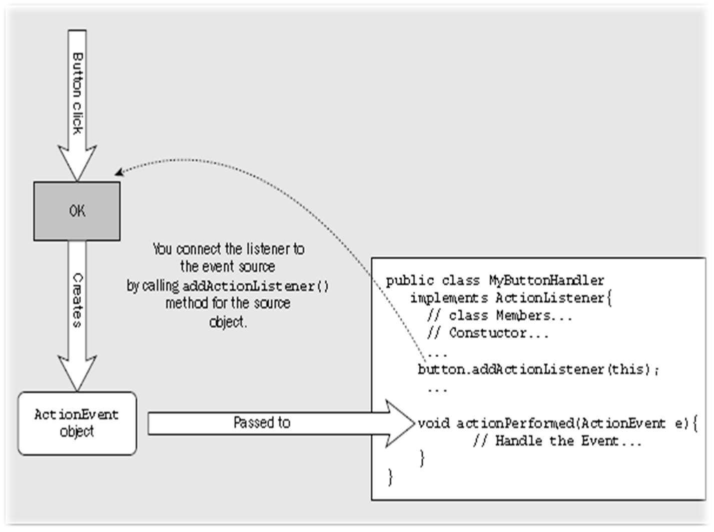

Slide 5

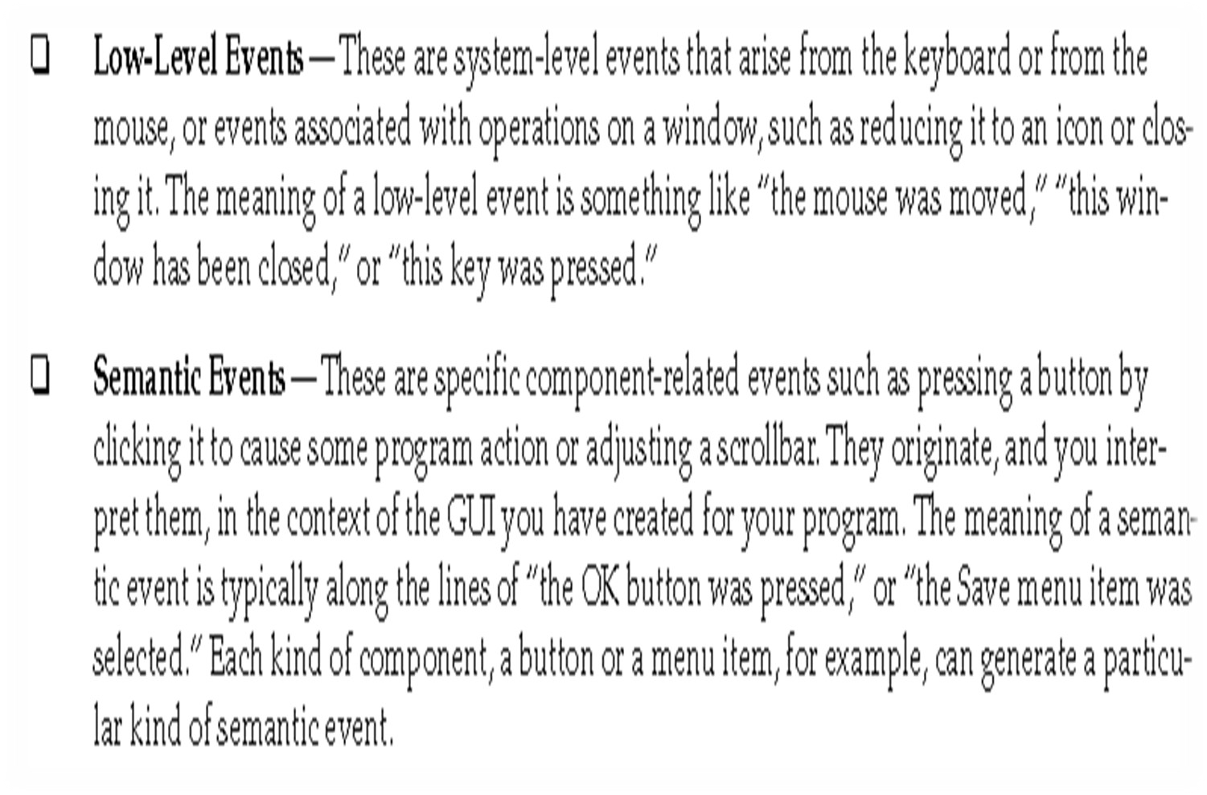

Slide 6

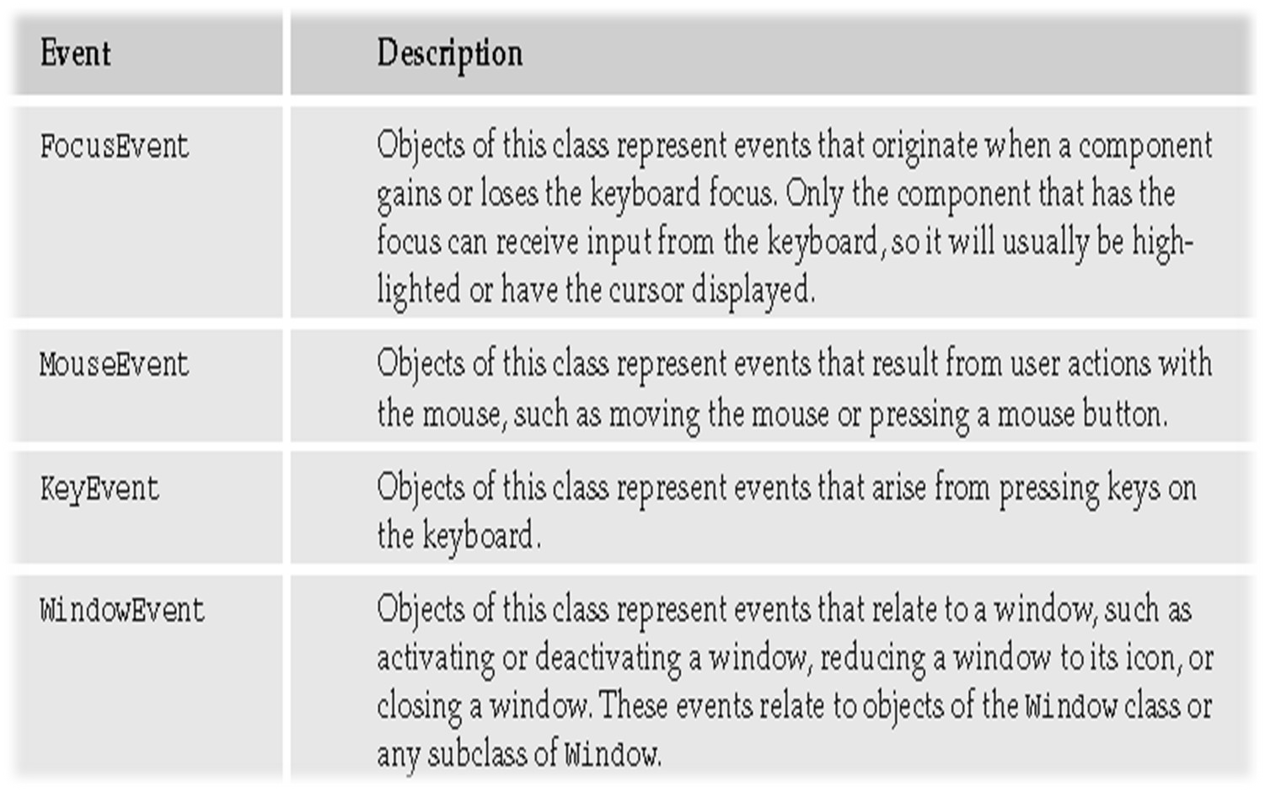

Slide 7
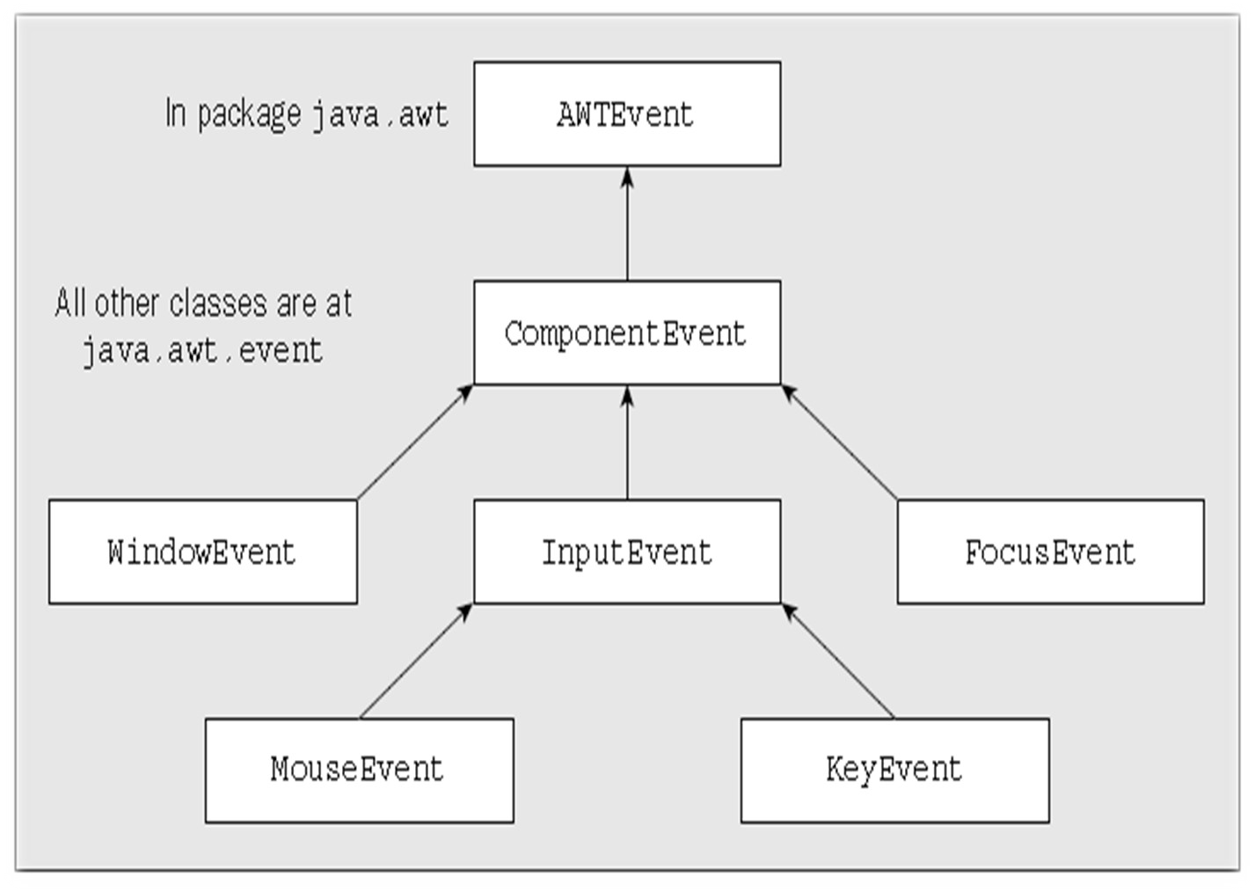

Slide 8

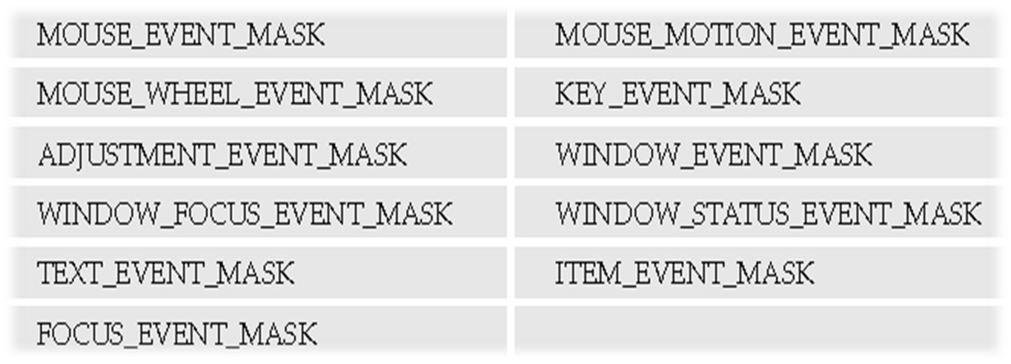
enableEvents(WINDOW_EVENT_MASK | MOUSE_EVENT_MASK);

Slide 9

WINDOW_OPENED
The event that occurs the first time a window is made visible.
WINDOW_CLOSING
The event that occurs as a result of the close icon being selected or Close being selected from the window’s system menu.
WINDOW_CLOSED
The event that occurs when the window has been closed.
WINDOW_ACTIVATED
The event that occurs when the window is activated obtains the focus, in other words. When another GUI component has the focus,you could make the window obtain the focus by clicking on it, for

Slide 10
WINDOW_DEACTIVATED
 The event that occurs when the window is deactivated—loses the focus, in other words. Clicking on another window would cause this event.
WINDOW_GAINED_FOCUS
The event that occurs when the window gains the focus. This implies that the window or one of its components will receive keyboard events.
WINDOW_LOST_FOCUS
The event that occurs when the window loses the focus. This implies that keyboard events will not be delivered to the window or any of its components.
WINDOW_ICONIFIED
The event that occurs when the window is minimized and reduced to an icon.
WINDOW_DEICONIFIED
The event that occurs when the window is restored from an icon.
WINDOW_STATE_CHANGED
The event that occurs when the window state changes—when it ismaximized or minimized, for instance.

Slide 11

processWindowFocusEvent(WindowEvent e)
This method is called for any window focus events that arise as long as such events are enabled for the window.
processWindowStateEvent(WindowEvent e)
This method is called for events arising as a result of the window changing state.

Slide 12

processEvent(AWTEvent e)
This method is called first for any events that are enabled for the component. If you implement this method and fail to call the base class method, none of the methods for specific groups of events will be called.
processFocusEvent(FocusEvent e)
 This method will be called for focus events, if they are enabled for the component.
processKeyEvent(KeyEvent e)
This method will be called for key events, if they are enabled for the component.

Slide 13
processMouseEvent(MouseEvent e)
This method will be called for mouse button events, if they are enabled for the component.
processMouseMotionEvent(MouseEvent e)
This method will be called for mouse move and drag events, if they are enabled for the component.
processMouseWheelEvent(MouseWheelEvent e)
This method will be called for mouse wheel rotation events, if they are enabled for the component

Slide 14

The WindowListener Interface
The WindowFocusListener Interface
The WindowStateListener Interface
The MouseListener Interface
The MouseMotionListener Interface
The MouseWheelListener Interface
The KeyListener Interface
The FocusListener Interface

Slide 15

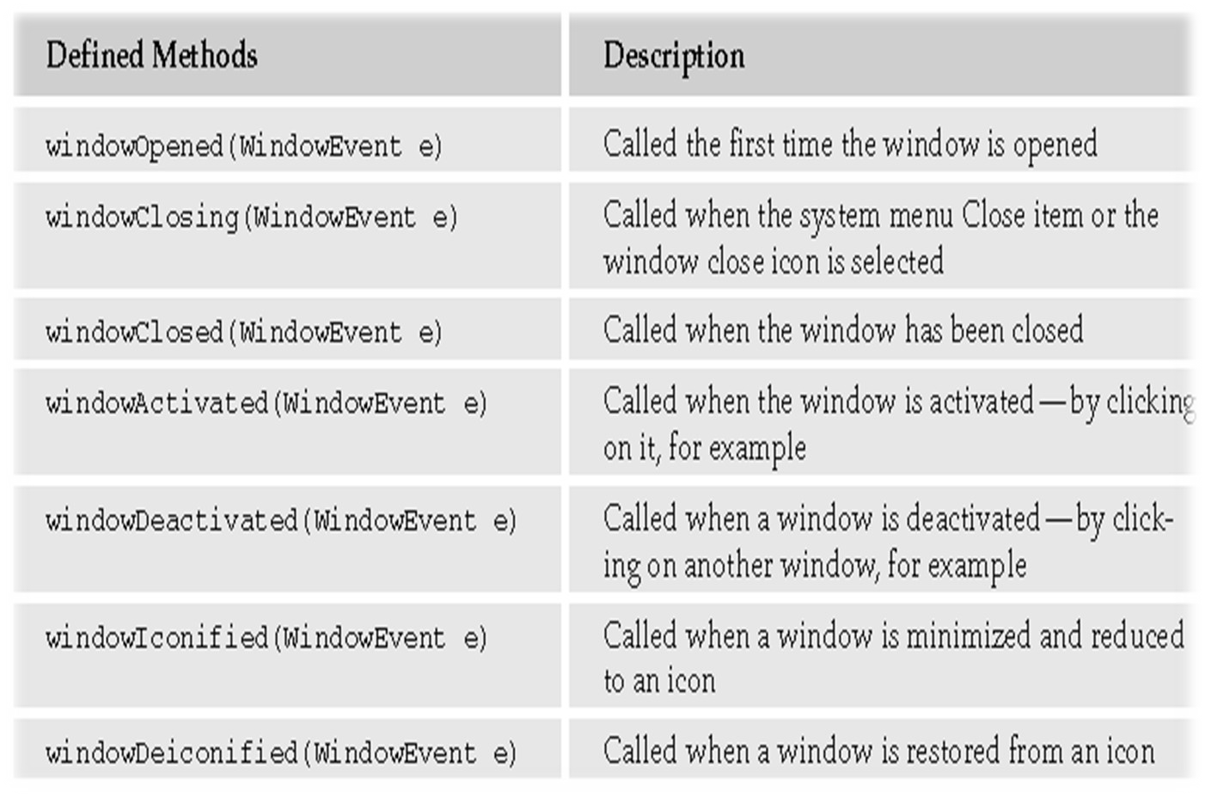

Slide 16

windowGainedFocus(WindowEvent e)
 Called when the window gains the focus such that the window or one of its components will receive keyboard events.
windowLostFocus(WindowEvent e)
Called when the window loses the focus. After this event, neither the window nor any of its components will receive keyboard events.
The WindowStateListener Interface
windowStateChanged(WindowEvent e)
Called when the window state changes when it is maximized or iconified.

Slide 17

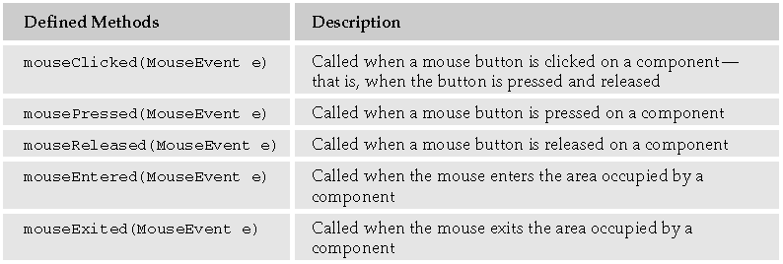

Slide 18
The MouseMotionListener Interface
mouseMoved(MouseEvent e)
Called when the mouse is moved within a component
mouseDragged(MouseEvent e)
Called when the mouse is moved within a component while a mouse button is held down
The MouseWheelListener Interface
mouseWheelMoved(MouseWheelEvent e)
Called when the mouse wheel is rotated

Slide 19
The KeyListener Interface
This interface defines methods to respond to events arising when a key on the keyboard is pressed or released.
keyTyped(KeyEvent e)
Called when a key on the keyboard is pressed and then released
keyPressed(KeyEvent e)
Called when a key on the keyboard is pressed
keyReleased(KeyEvent e)
Called when a key on the keyboard is released
The FocusListener Interface
This interface defines methods to respond to a component gaining or losing the focus.
focusGained(FocusEvent e)
 Called when a component gains the keyboard focus
focusLost(FocusEvent e)
 Called when a component loses the keyboard focus

Slide 20

FocusAdapter
WindowAdapter
KeyAdapter
MouseAdapter
MouseMotionAdapter
MouseInputAdapter

Slide 21

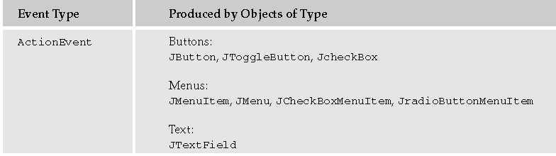
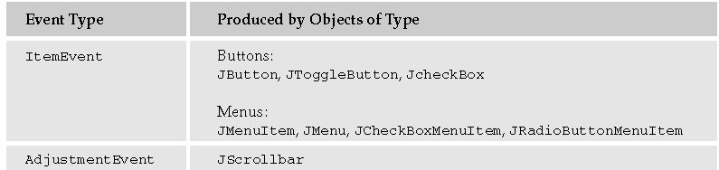

Slide 22
Semantic Event Listeners
ActionListener
void actionPerformed(ActionEvent e)
ItemListener
void itemStateChanged(ItemEvent e)
AdjustmentListener
void adjustmentValueChanged(AdjustmentEvent e)

Slide 23
The End

